Slide 1
JavaScript Code Convention,
Linters: JSLint, JSHint, ESLint
by Sofiia Matsyhin

Slide 2
JavaScript Coding Conventions
Coding conventions are style guidelines for programming. They typically cover:
Naming and declaration rules for variables and functions.
Rules for the use of white space, indentation, and comments.
Programming practices and principles
Coding conventions secure quality:
Improves code readability
Make code maintenance easier
Coding conventions can be documented rules for teams to follow, or just be your individual coding practice.

Slide 3
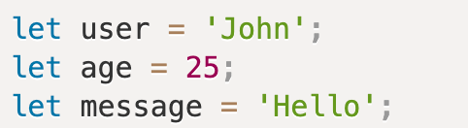
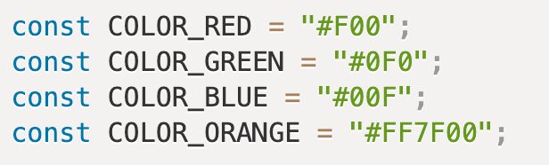
Variable Names
Use camelCase for identifier names (variables and functions).
All names start with a letter.
There is a widespread practice to use constants as aliases for difficult-to-remember values that are known prior to execution.
Such constants are named using capital letters and underscores.

Slide 4
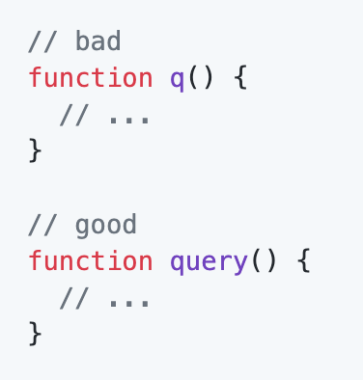
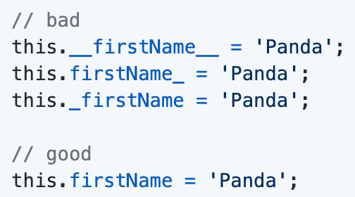
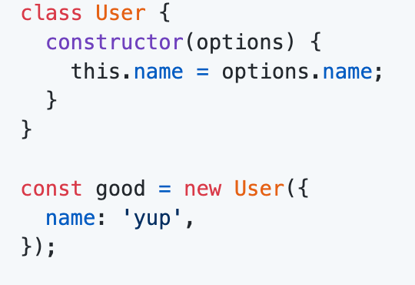
Naming Conventions
Do not use trailing or leading underscores.
Avoid single letter names. Be descriptive with your naming.
Use PascalCase only when naming constructors or classes

Slide 5
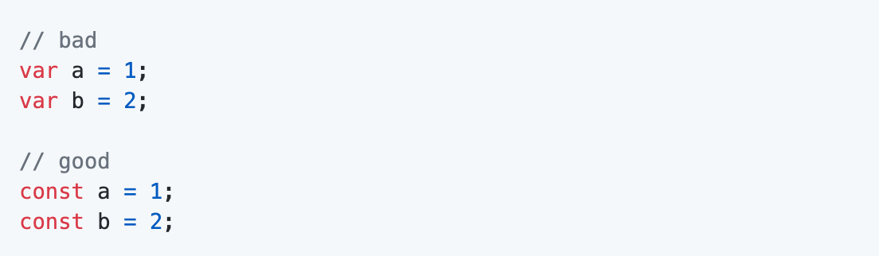
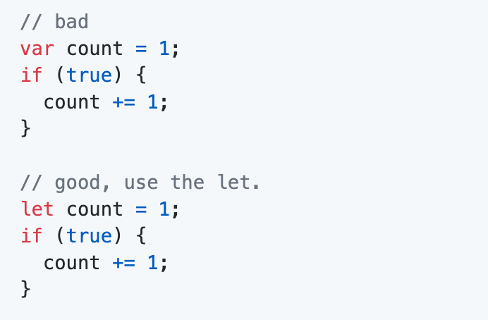
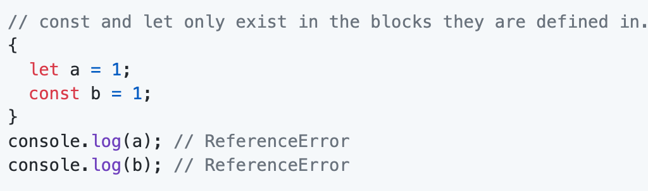
Use let or const
Use const for all of your references, avoid using var.
Why? This ensures that you can’t reassign your references, which can lead to bugs and difficult to comprehend code.
If you must reassign references, use let instead of var.
Why? Let is block-scoped rather than function-scoped like var.
Note that both let and const are block-scoped.

Slide 6
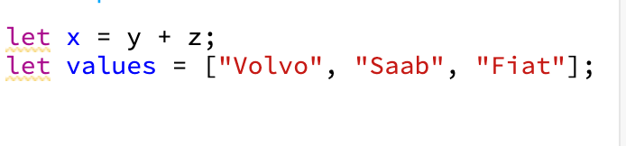
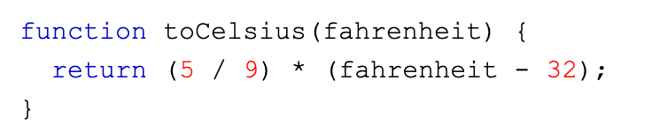
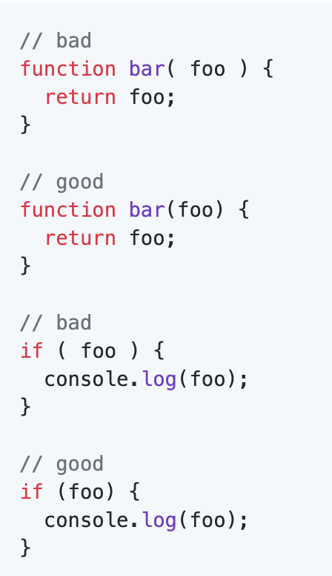
Whitespace
Spaces Around Operators:
Always put spaces around operators ( = + - * / ), and after commas
Always use 2 spaces for indentation of code blocks:
BUT!
Do not pad your blocks with blank lines
Do not use multiple blank lines to pad your code.Do not add spaces inside parentheses
Do not add spaces inside brackets
Avoid having lines of code that are longer than 80 characters.
Avoid spaces before commas and require a space after commas
Avoid spaces between functions and their invocations

Slide 7
Object Rules
General rules for object definitions:
Place the opening bracket on the same line as the object name.
Use colon plus one space between each property and its value.
Use quotes around string values, not around numeric values.
Do not add a comma after the last property-value pair.
Place the closing bracket on a new line, without leading spaces.
Always end an object definition with a semicolon.

Slide 8
JavaScript Linters

Slide 9
What are JavaScript linters?
JavaScript linters are tools that you can use to help you debug your code.
They scan your scripts for common issues and errors, and give you back a report with line numbers that you can use to fix things.
In addition to actual bugs and errors, they also check for subjective, stylistic preferences as well. Did you include a space between the function name and parentheses? Did you use single or double quotes around strings? Things like that.

Slide 10
Linting Tools
The three most popular JS linters are:
JSLint. Highly opinionated and based on Douglas Crockford’s Javascript: The Good Parts, it does not allow for much configuration.
JSHint. Comes loaded with sensible defaults, but allows for a lot more configuration than JSLint.
ESLint. An extremely configurable linter that also supports JSX and can autoformat scripts to match your preferred code formatting style.

Slide 11
Benefits of linting JavaScript code
Linters detect common programming errors and ensure that certain best practices are followed. Using them allows you to avoid some of JavaScript's confusing language features.
As a result, linted code is likely to contain fewer bugs.
Detecting these simple errors before a manual code review also makes reviewing the code more effective since the reviewer can focus on more complex issues.

Slide 12
How Linters work
JavaScript linters parse and inspect source code, and then analyze the code's syntax and structure.
If any code violates the rules defined by the linter a warning is shown. The warning explains what part of the code might lead to unexpected behavior and why.

Slide 13
Setting up linting for your project
The easiest way to lint a bit of code is by using the online versions of JSLint, JSHint or ESLint. You can just paste your source code and the tools will lint the code for you.
However, this isn't convenient for anything but very small projects. For larger projects, you want to regularly and automatically lint all JavaScript files in the project.
The best way to achieve that is using a task runner like Grunt or Gulp. You can set them up to run the linter every time you make a change to your source code.

Slide 14
USEFUL LINKS
https://github.com/airbnb/javascript
https://google.github.io/styleguide/jsguide.html
https://www.w3schools.com/js/js_conventions.asp

Slide 15


